Slide 1
Studying in Xiamen University, China
International Office (January 2022)
Universitas Hasanuddin

Slide 2
Xiamen Overview
Located in the southeast coast of China
Made up of Xiamen Island, Gulangyu and some coastal areas on the north bank of inland Jiulong River.
More information: https://admissions.xmu.edu.cn/Magic_Xiamen/Xiamen_Overview.htm

Slide 3

Botanical Garden https://www.xmenglish.cn/en/travl/attractions/201904/t20190419_5271211.htm

Slide 4
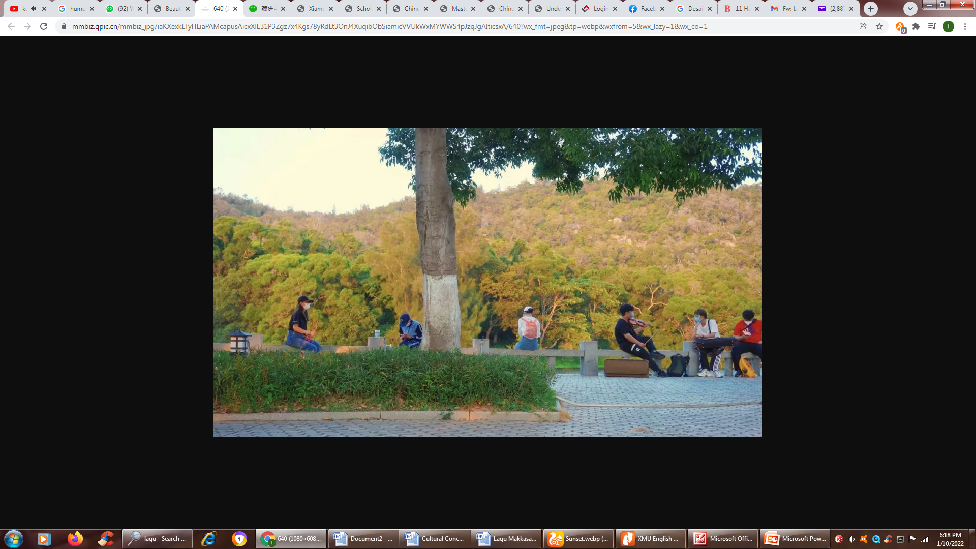
Late Autumn in Xiamen https://mp.weixin.qq.com/s/rmscWuIdnoxXgljLbiOTDQ

Slide 5
Why XMU
Beautiful Campuses, life@xmuhttps://admissions.xmu.edu.cn/WHY_XMU/Life_at_XMU.htm
Video:https://admissions.xmu.edu.cn/cn/info/1063/2046.htm

Slide 6
Application Guides
Bachelor's Programs: https://admissions.xmu.edu.cn/Admissions/Undergraduate_Students.htm
Master's programs: https://admissions.xmu.edu.cn/Admissions/Master_s_Students.htm
Doctoral Programs:
https://admissions.xmu.edu.cn/Admissions/Doctoral_students.htm

Slide 7
Scholarship
Chinese Government Scholarship
The Center for Language Education And Cooperation (CLEC) Scholarships
Fujian Provincial Government Scholarship
More Information: https://admissions.xmu.edu.cn/Scholarships/Scholarships_Information.htm

Slide 8
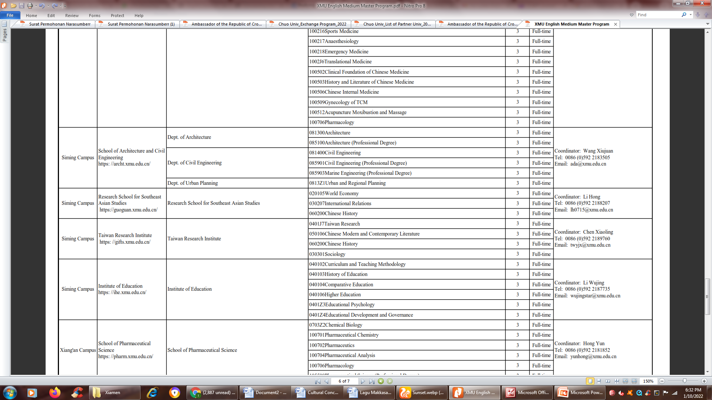
English Medium Master Program

Slide 9
Other Programs
https://admissions.xmu.edu.cn/Programs/English_Medium_Master_s.htm

